Slide 1
ECMAScript (European Computer Manufacturer's Association)
By Roee Angel

Slide 2

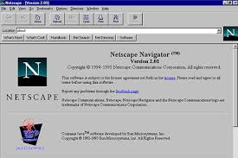



The History of JS
In 1993, developer Marc Andreessen helped the National Center for Supercomputing Applications to lunch Mosaic: a user-friendly, graphical web browser.
Microsoft's reply, Internet Explorer, loomed ominously on the horizon.
In 1995 Netscape brokered a deal with another Microsoft competitor, Sun Microsystems, which was debuting a major programming language, Java.
JS was created in May of 1995 and written in 10 days by Brendan Eich. JavaScript was first known as LiveScript, but Netscape changed its name to JavaScript, possibly because of the excitement being generated by Java. (JAVS IS NOT JS)
JS conforms to the ECMAScript specification.

Slide 3
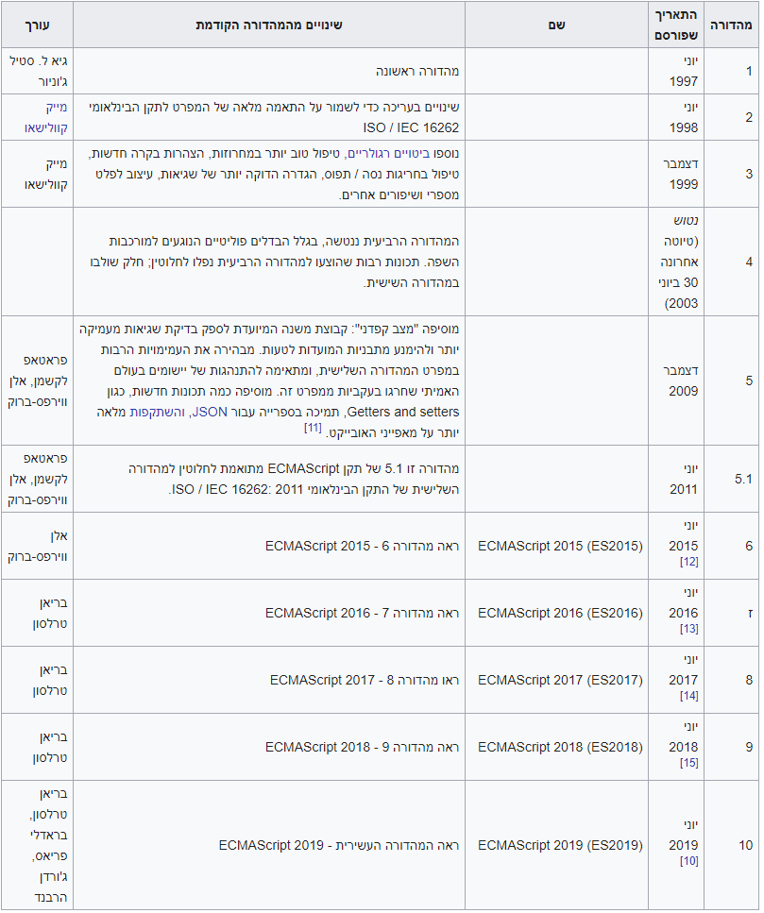
Ecma International An organization that creates standards for technologies.
By reading the ECMAScript specification, you learn how to create a scripting language. By reading the JavaScript documentation, you learn how to use a scripting language.
The full form of ECMA is European Computer Manufacturer's Association. It is a trademark scripting language specification. JavaScript is a language based on ECMAScript. A standard for scripting languages like JavaScript, JScript is ECMAScript etc. JavaScript is considered as one of the most popular implementations of ECMAScript.
In 1997 JS standardized to ECMA-262 The standard of scripting languages like JavaScript is ECMAScript. JavaScript is basically ECMAScript at its core but builds upon it. Languages such as ActionScript, JavaScript, JScript all use ECMAScript as its core.
They all use the same engine.

Slide 4



A JavaScript engine
JavaScript engines are commonly found in web browsers, including V8 in Chrome, SpiderMonkey in Firefox, and Chakra in Edge. Each engine is like a language module for its application, allowing it to support a certain subset of the JavaScript language.
Releasing a new edition of ECMAScript does not mean that all JavaScript engines in existence suddenly have those new features. It is up to the groups or organizations who are responsible for JavaScript engines to be up-to-date about the latest ECMAScript specification, and to adopt its changes.

Slide 5
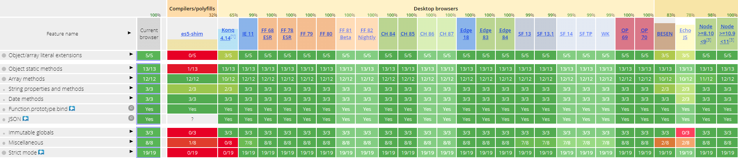
ES5
ECMAScript 5 (December 2009)
ES5 is the oldest major JavaScript version for which you're still likely to find entire applications or important libraries written in it.
The fundamental syntax and concepts you really need to understand about ES5 almost all revolve around the topics of scope and functions.

Slide 6
ES6, ES2015, and ECMAScript 2015
ECMAScript 6(2015) It is the sixth edition of the ECMA-262 standard.
This edition of ECMAScript changed its name from ES6 to ES2015 because in 2015 Ecma International decided to switch to annual releases of ECMAScript.
ES6 is an next-gen of JavaScript, the ecma technical committee 39 governs ecma specification, they discovered new features to the javascript.
ES6 can`t compile directly in browsers, so need an compiler from ES6 to ES5, for that compiling using babel, it produce the browser compatible javascript.

Slide 7
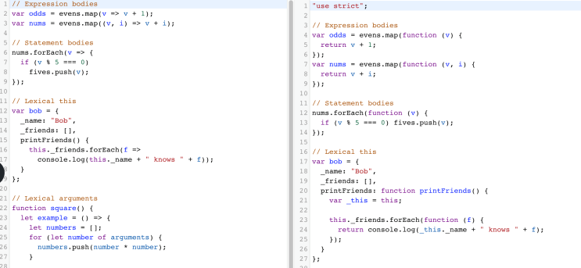

Babel
A transpiler that can convert ES6 code to ES5 code.
Developers can use the shiny new features that come with ES6, but may be concerned with cross-browser compatibility for their web apps. At the time of the writing of this article, Edge and Internet Explorer do not fully support features from the ES6 specification.
All of the major browsers fully support ES5, so they can run the code without any issues.

Slide 8
ES7
ECMAScript 7(2016)
They decided to release a new version of ECMAScript every year starting in 2015. A yearly update means no more big releases like ES6.
ECMAScript 2016(ES7) introduced only two new features:
Array.prototype.includes()
Exponentiation operatorThey decided to release a new version of ECMAScript every year starting in 2015. A yearly update means no more big releases like ES6.
ECMAScript 2016(ES7) introduced only two new features:
Array.prototype.includes()
Exponentiation operator

Slide 9
ES8
ECMAScript 8(2017)
Major new features:
Async Functions (Brian Terlson)
Shared memory and atomics (Lars T. Hansen)
Minor new features:
Object.values/Object.entries (Jordan Harband)

Slide 10
ES9
ECMAScript 9(2018)
Major new features:
Asynchronous Iteration (Domenic Denicola, Kevin Smith)
Rest/Spread Properties (Sebastian Markbåge)

